Slide 1
Rights and rules applicable to UK nationals and their family members in Poland after 31.01.2020
March, 2020

Slide 2
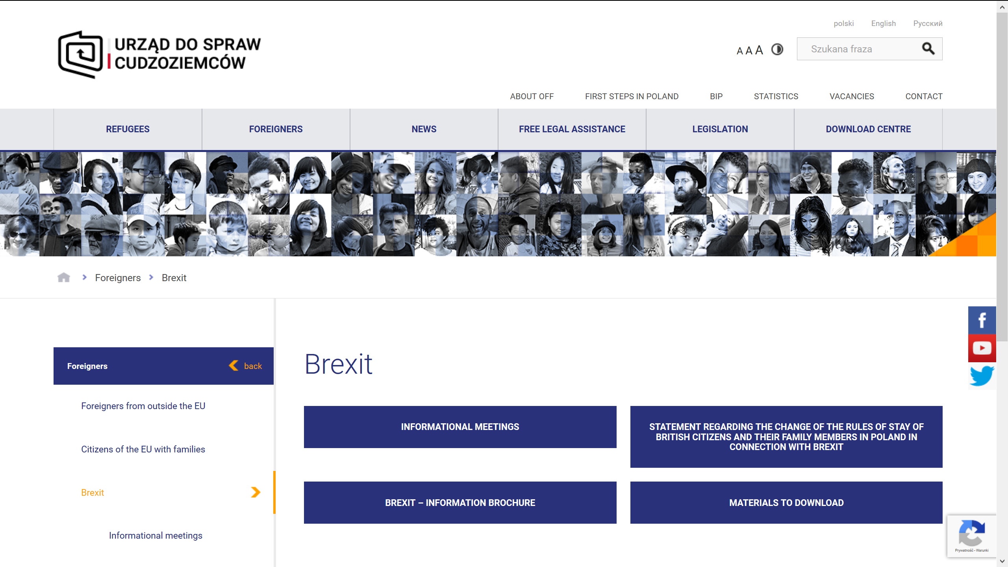
Brexit – immigration information
https://udsc.gov.pl/en/cudzoziemcy/brexit/

Slide 3
Withdrawal Agreement (WA)
Agreement on the withdrawal of the United Kingdom of Great Britain and Northern Ireland from the European Union and the European Atomic Energy Community Official Journal of the European Union L29/7 31.01.2020 (Part Two Citizens’ rights)

Slide 4
EU and national legislation
EC Executive decision on documents issued by Member States on basis of Art. 18 and 26 of the WA adopted on 21.02.2020
Necessary changes to national law are being drafted, to be implemented later in 2020, effective from January 2021.

Slide 5
Definitions
Transition period – a period ending on 31.12.2020 during which EU law on free movement of persons will continue to apply to UK nationals.
Host State – in respect of United Kingdom nationals and their family members, the Member State in which they exercised their right of residence in accordance with Union law before the end of the transition period and in which they continue to reside thereafter, e.g. Poland
Beneficiaries of the Withdrawal Agreement – persons within the scope of Part Two of the WA.
Family members – core, extended, prior, existing, future.
Frontier workers - United Kingdom nationals who pursue an economic activity in accordance with Article 45 or 49 TFEU in one or more States in which they do not reside

Slide 6
In short
Transition period from the Brexit date until December 31, 2020. During this time the rules of stay and work of UK nationals in Poland will remain unchanged.
Poland is about to choose a declaratory scheme for residence rights confirmation. After the end of transition period UK nationals and their family members will have the right to reside in Poland, if:
they exercised the right of stay in Poland in accordance with EU law before the end of the transitional period;
they continue to reside in Poland.
The right of permanent stay will in principle be granted after five years of uninterrupted residence (in accordance with EU law under the conditions laid down in Directive 2004/38/EC). Periods of legal residence or work in accordance with Union law falling before and after the end of the transitional period will be included in the required period of entitlement to acquire the right of permanent residence.
A document with the annotation that it was issued in accordance with the Brexit agreement shall be a confirmation of the right of residence or right of permanent residence.
Current documents will be exchanged by voivodship offices competent for the place of stay – a form to be filled in. New documents will be issued by voivodship offices upon application.

Slide 7
Details
WA benefits are limited to the host State
WA benefits are limited to the existing family members with exception of future children
Persons who, at the end of the transition period, enjoy a right of residence in their capacity as family members of Union citizens or United Kingdom nationals, cannot become right holders
Posted workers are not covered by the WA
WA provides a „life-long protection” - unless you cease to meet the conditions set out in it

Slide 8
What should you do
Read https://udsc.gov.pl/en/cudzoziemcy/brexit/, e-mail questions or call 22 60 175 75 if necessary.
Register your stay before the end of 2020.
Exchange your documents between 1st January 2021 and 31 December 2021. Current documents will remain valid till 1st January 2022.
No fees.
Queue with other EU citizens.
Your fingerprints will be taken.
Continue enjoying your stay in Poland.

Slide 9
THANK YOU
Tomasz Cytrynowicz
Director
Bureau of the Head of the Office for Foreigners
T: +48 (22) 60-175-75
Tomasz.Cytrynowicz@udsc.gov.pl
Office for Foreigners
ul. Taborowa 33
02-699 Warszawa
www.udsc.gov.pl

